Slide 1
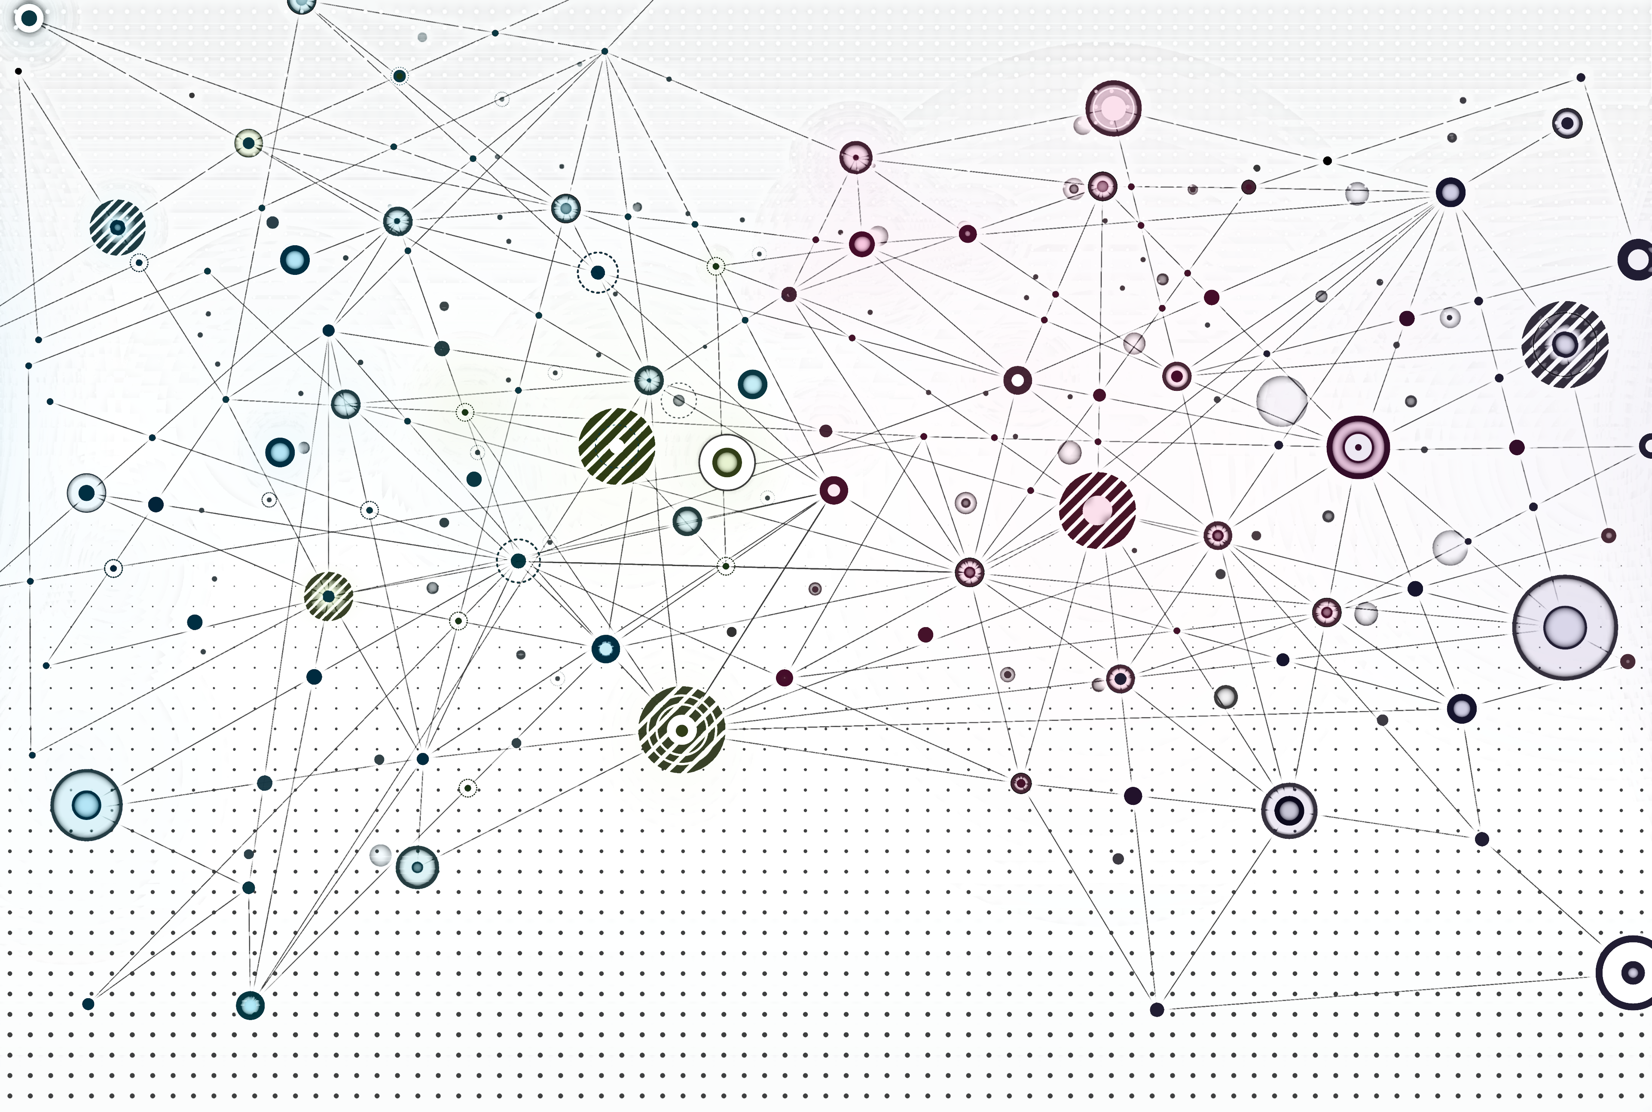
Introduction to Graph Neural Networks

Slide 2
Overview
Recap
Deep learning meets graphs
Graph convolutional networks

Slide 3
Recap

Slide 4
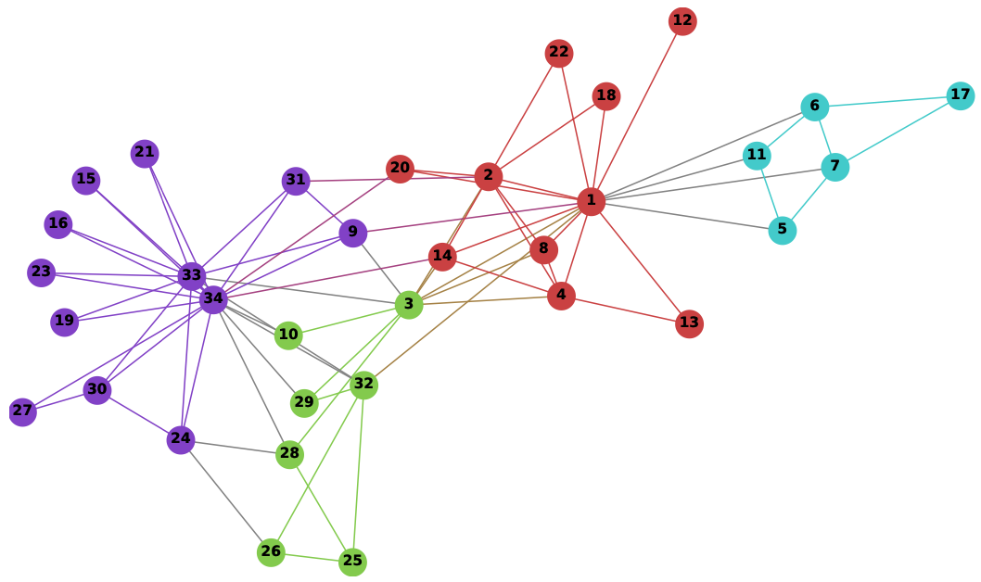
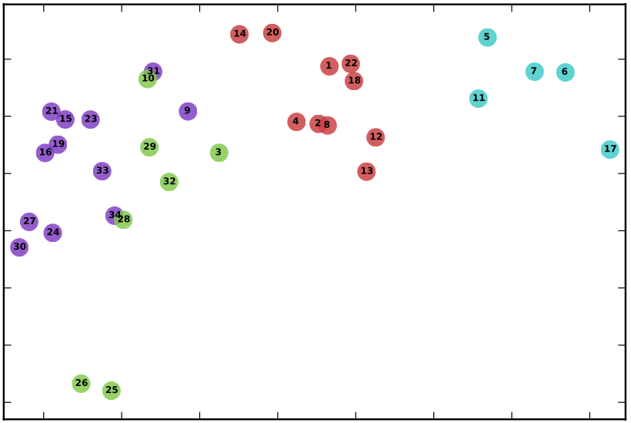
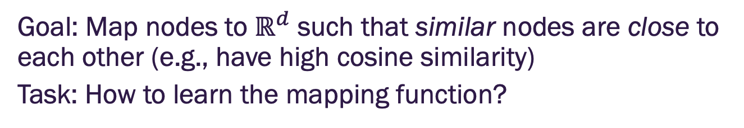
Node embeddings
Goal: Map nodes to $ℝ^{d}$ such that similar nodes are close to each other (e.g., have high cosine similarity)
Task: How to learn the mapping function?

Slide 5
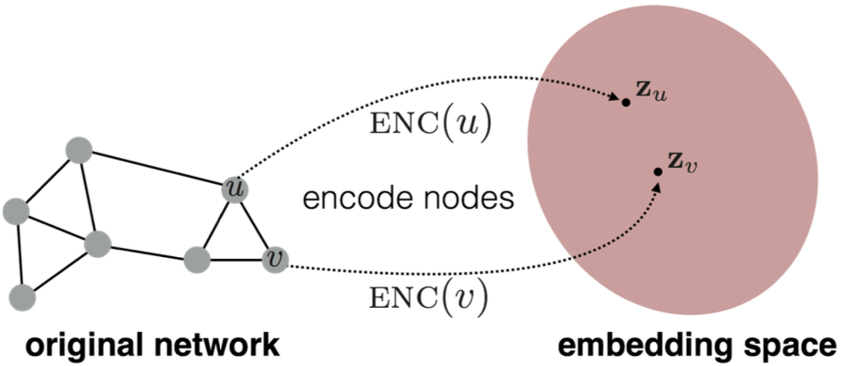
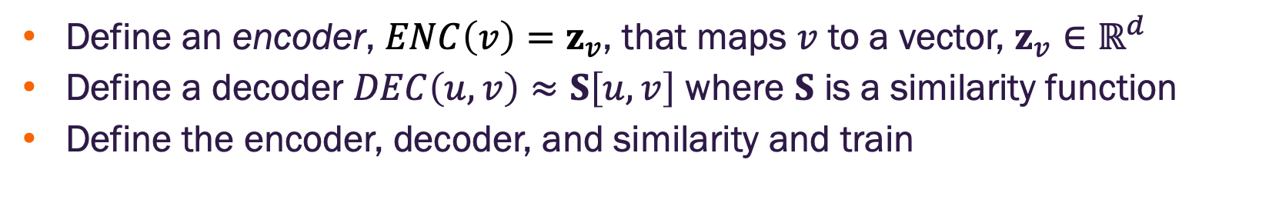
Node embeddings
Define an encoder, $ENC\left(v\right)=z_{v}$, that maps $v$ to a vector, $z_{v}∈ℝ^{d}$
Define a decoder $DEC\left(u,v\right)≈S\left[u,v\right]$ where $S$ is a similarity function
Define the encoder, decoder, and similarity and train
Image credit: Hamilton 2020

Slide 6
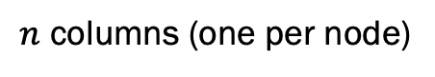
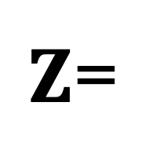
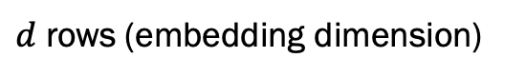
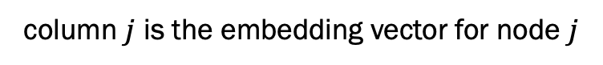
Shallow embeddings
Simplest approach, the encoder is just a lookup
column $j$ is the embedding vector for node $j$
$Z$=
$d$ rows (embedding dimension)
embedding
matrix
$n$ columns (one per node)

Slide 7
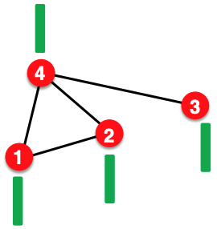
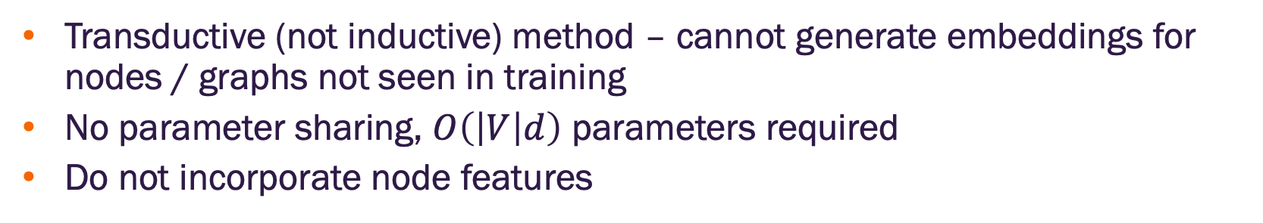
Shallow embedding limitations
Transductive (not inductive) method – cannot generate embeddings for nodes / graphs not seen in training
No parameter sharing, $O\left(\left|V\right|d\right)$ parameters required
Do not incorporate node features
Node feature vector
(e.g. protein properties in a protein-protein interaction graph)
Matrix factorization / random walk embeddings do not incorporate such node features
Solution: Graph neural networks
Image credit: Jure Leskovec, http://cs224w.stanford.edu

Slide 8
Deep learning meets graphs

Slide 9

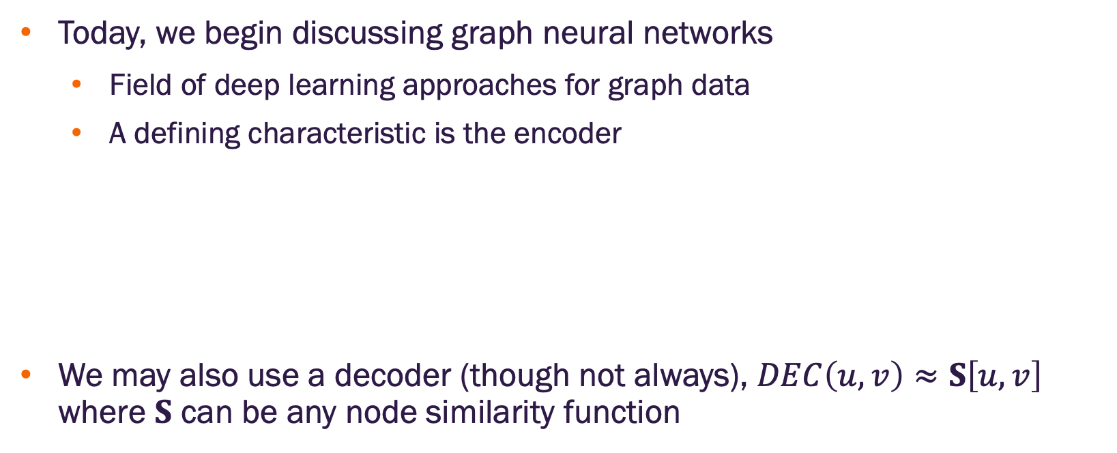
Deep graph encoders (going beyond shallow embeddings)
Today, we begin discussing graph neural networks
Field of deep learning approaches for graph data
A defining characteristic is the encoder
We may also use a decoder (though not always), $DEC\left(u,v\right)≈S\left[u,v\right]$ where $S$ can be any node similarity function
multiple iterations (layers) of non-linear transformations based on graph structure
$$ENC\left(v\right)≡$$

Slide 10
Intra-graph machine learning tasks
Node classification – given information about the node (may include neighbors, relationships, attributes), infer class membership (usually an attribute)
Edge prediction – given information about two nodes, determine if a given relation exists between them
Community detection (node clustering) – detection of “meaningful” node groups
Community Detection
Edge Prediction
?
A
B
Node Classification

Slide 11
Whole graph and inter-graph machine learning tasks
Whole graph classification and regression – given one entire graph, infer class membership or estimate (regress) a related numerical property
Inter graph tasks – given multiple graphs estimate the similarity between graphs and/or identify clusters
Classification
A
B
Regression
Y
G₁
G₂
Clustering
C₁ = {G₁, G₃, G₄}
C₂ = {G₂}
G₃
G₄

Slide 12
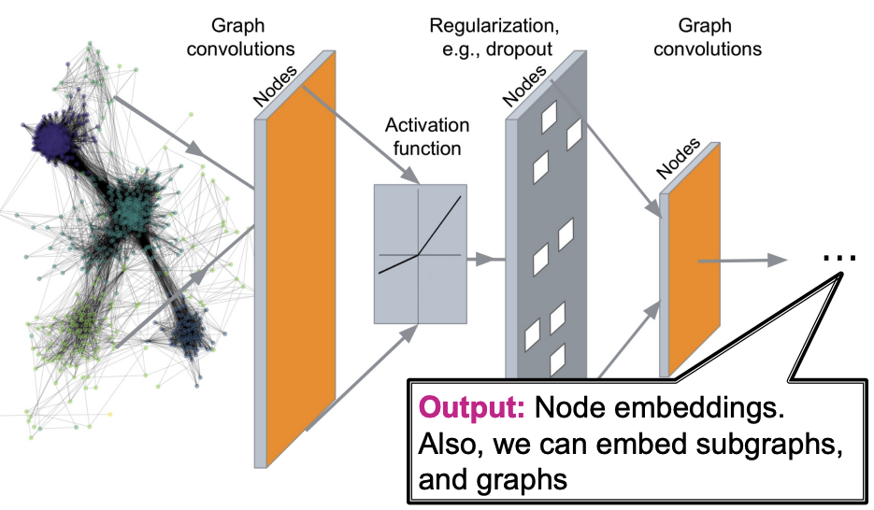
Borrowing concepts from deep learning
Image credit: Jure Leskovec, http://cs224w.stanford.edu
Notes:
We would like to develop deep networks that:
learn meaningful features based on both graph structure and node / edge features
are inductive – i.e., new nodes or graphs can be processed by the model
build on existing knowledge from deep learning on other data types

Slide 13
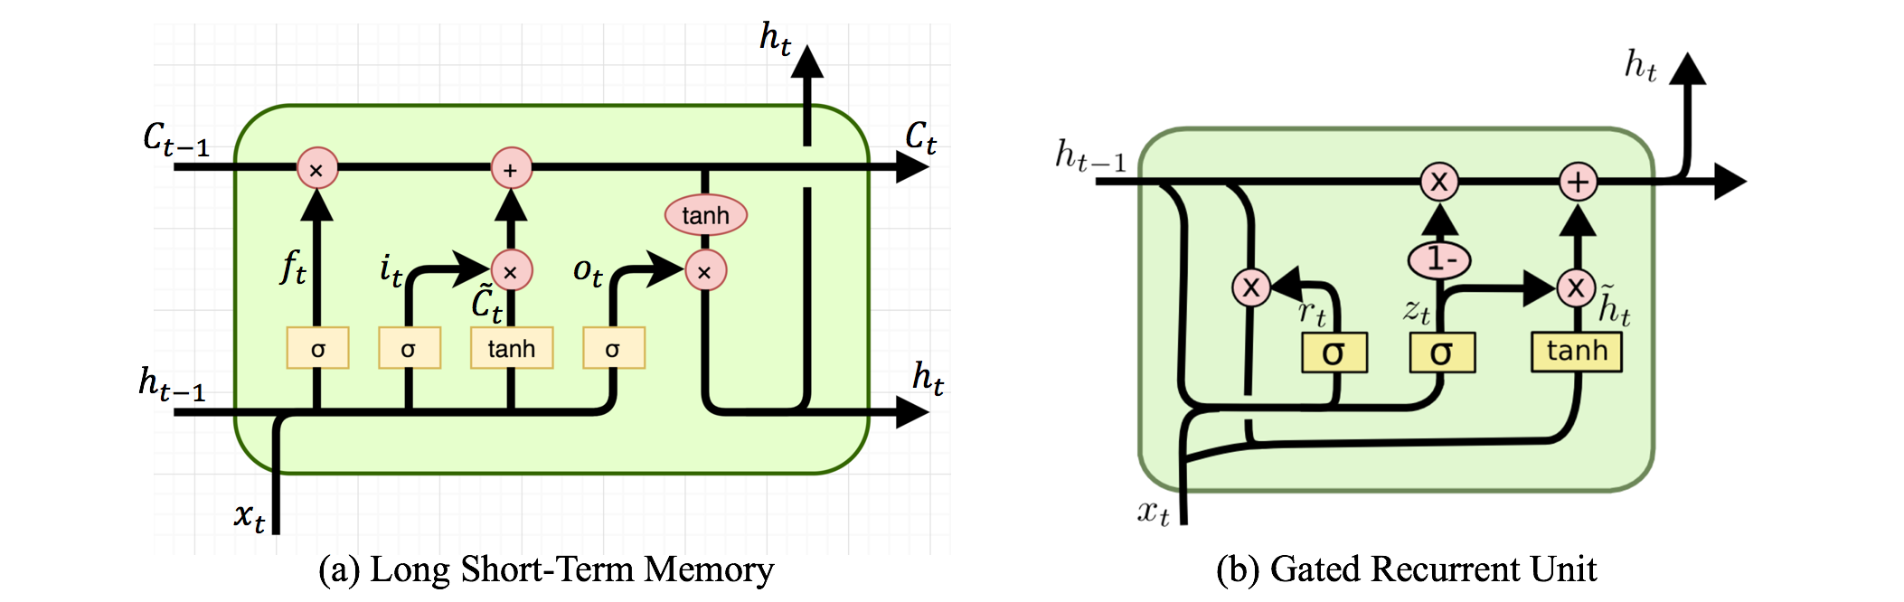
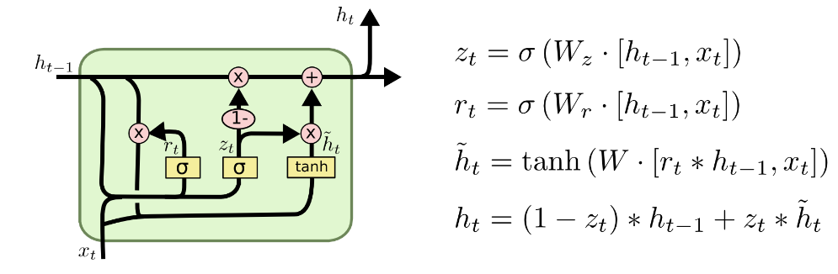
Why can’t we just use existing methods?
Standard ML methods and deep learning assume fixed-sized and ordered inputs

Slide 14
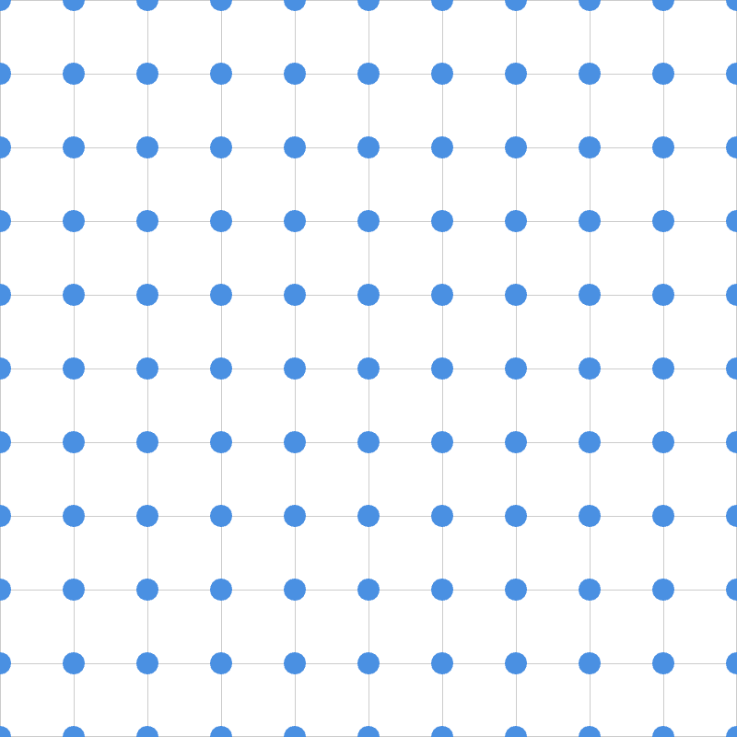
Modern ML toolbox assumes regularity
Graphs contain arbitrary node and edge counts
Graph nodes do not have an objective ordering
Different node types may have different features
VS
Graph Data
Images
Text

Slide 15
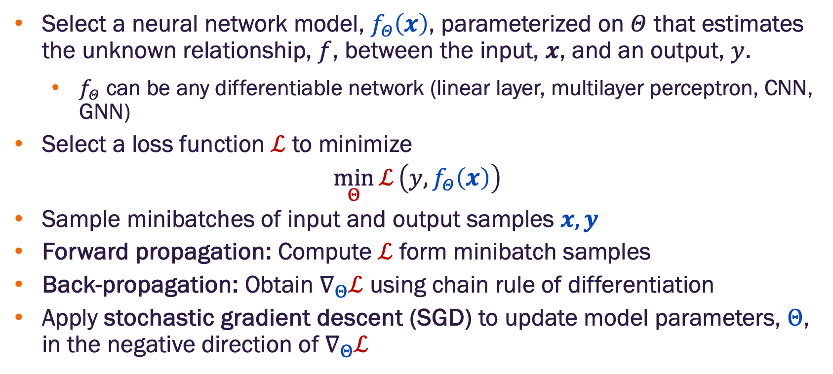
Review of deep learning basics
Select a neural network model, $f_{Θ}\left(x\right)$, parameterized on $Θ$ that estimates the unknown relationship, $f$, between the input, $x$, and an output, $y$.
$f_{Θ}$ can be any differentiable network (linear layer, multilayer perceptron, CNN, GNN)
Select a loss function $ℒ$ to minimize
$$\min_{Θ}{ℒ}\left(y,f_{Θ}\left(x\right)\right)$$
Sample minibatches of input and output samples $x,y$
Forward propagation: Compute $ℒ$ form minibatch samples
Back-propagation: Obtain $∇_{Θ}ℒ$ using chain rule of differentiation
Apply stochastic gradient descent (SGD) to update model parameters, $Θ$, in the negative direction of $∇_{Θ}ℒ$
How can we do this for graph networks?

Slide 16
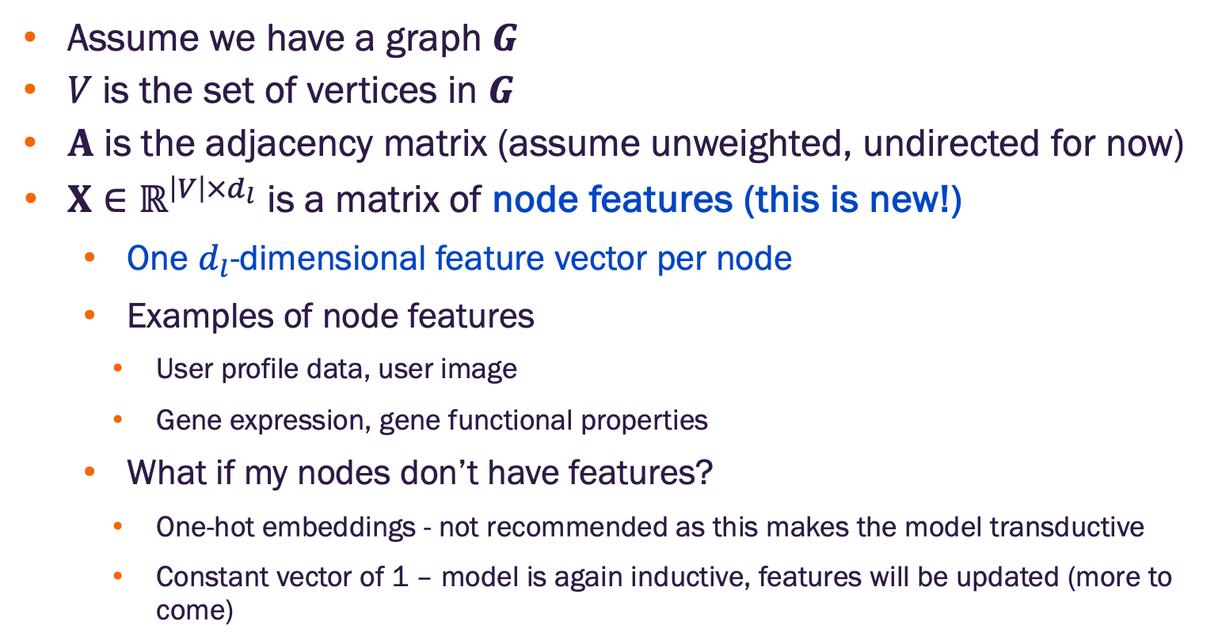
Graph deep learning paradigm
Assume we have a graph $G$
$V$ is the set of vertices in $G$
$A$ is the adjacency matrix (assume unweighted, undirected for now)
$X∈ℝ^{\left|V\right|×d_{l}}$ is a matrix of node features (this is new!)
One $d_{l}$-dimensional feature vector per node
Examples of node features
User profile data, user image
Gene expression, gene functional properties
What if my nodes don’t have features?
One-hot embeddings - not recommended as this makes the model transductive
Constant vector of 1 – model is again inductive, features will be updated (more to come)

Slide 17
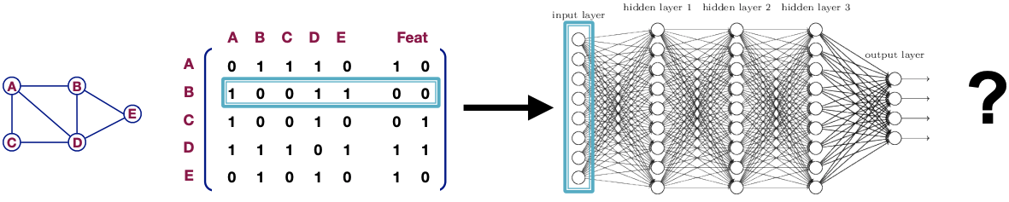
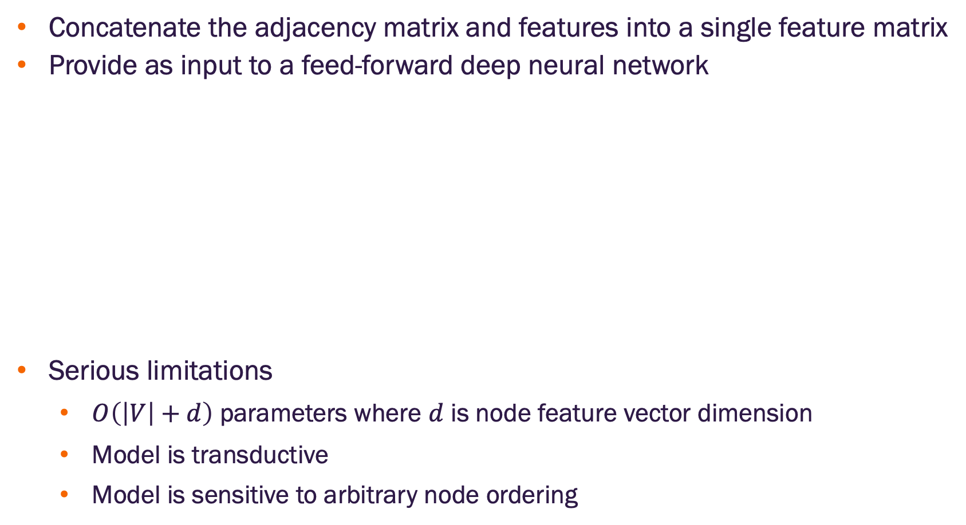
A naïve approach to graph deep learning
Concatenate the adjacency matrix and features into a single feature matrix
Provide as input to a feed-forward deep neural network
Serious limitations
$O\left(\left|V\right|+d\right)$ parameters where $d$ is node feature vector dimension
Model is transductive
Model is sensitive to arbitrary node ordering
Image credit: Jure Leskovec, http://cs224w.stanford.edu
What else can we do?

Slide 18
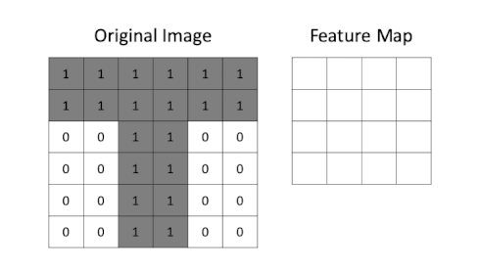
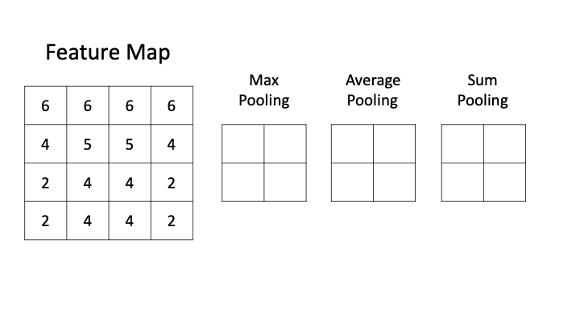
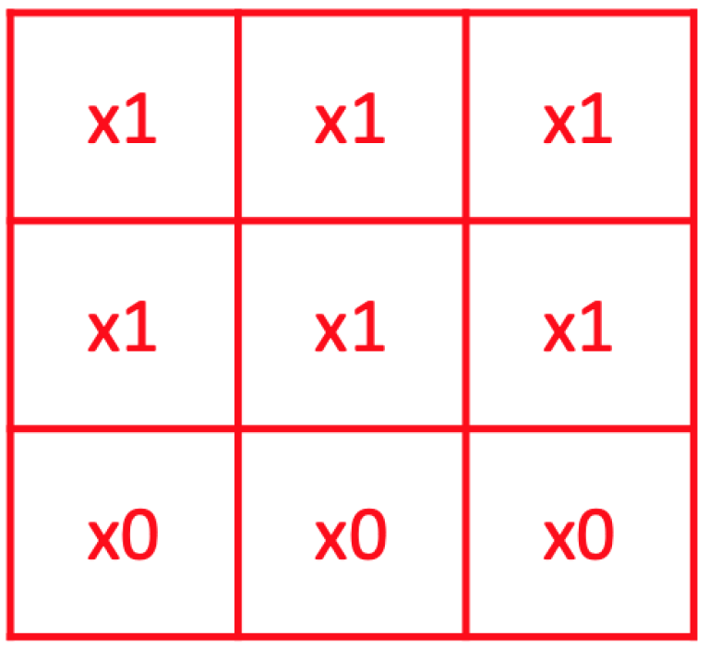
Can we apply convolutional network approaches?
Max pooling is common, but average and sum pooling are also used

Slide 19
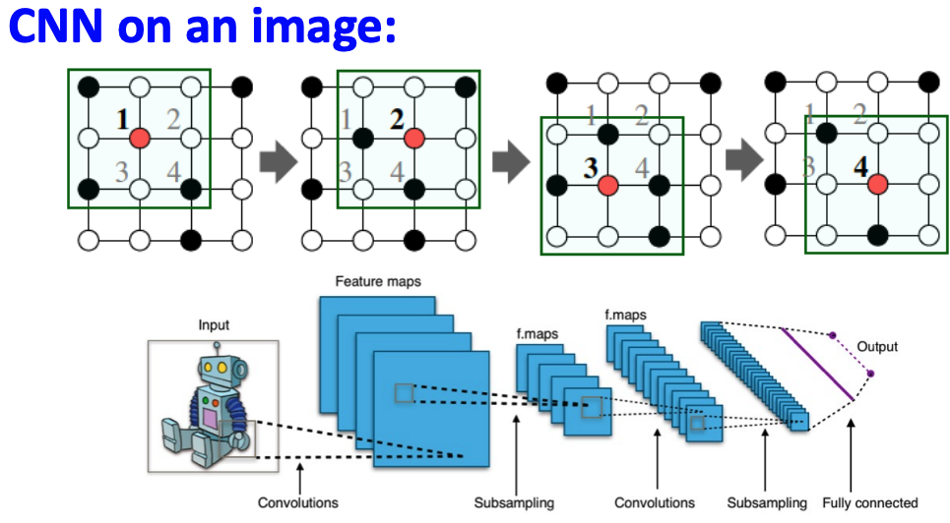
Can we apply convolutional network approaches?
Generalize convolution beyond lattices (images)
Leverage node features
Image credit: Jure Leskovec, http://cs224w.stanford.edu

Slide 20
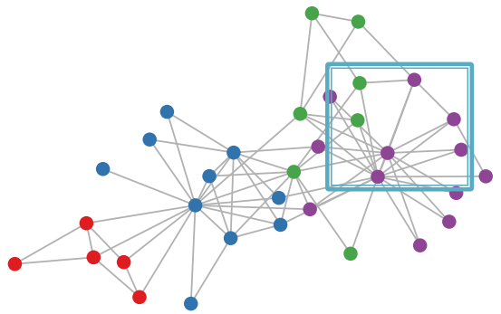
Can we apply convolutional network approaches?
Graphs are generally NOT regular lattices
There is no fixed reference (locality) for a sliding window (i.e., the convolution filter)
Graphs are permutation invariant
What does this mean?
Image credit: Jure Leskovec, http://cs224w.stanford.edu

Slide 21
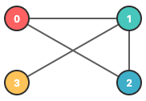
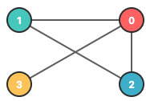
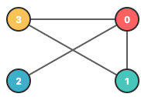
Permutation invariance
Graphs do not have a canonical node ordering
We can arbitrarily assign different node orders without altering the graph structure
Desiderata – a graph embedding function should produce the same result (graph embedding) for any node ordering
Structurally equivalent
https://ml4g.masinolab.com/topics/gnns/gnn-permutation-demo.html

Slide 22
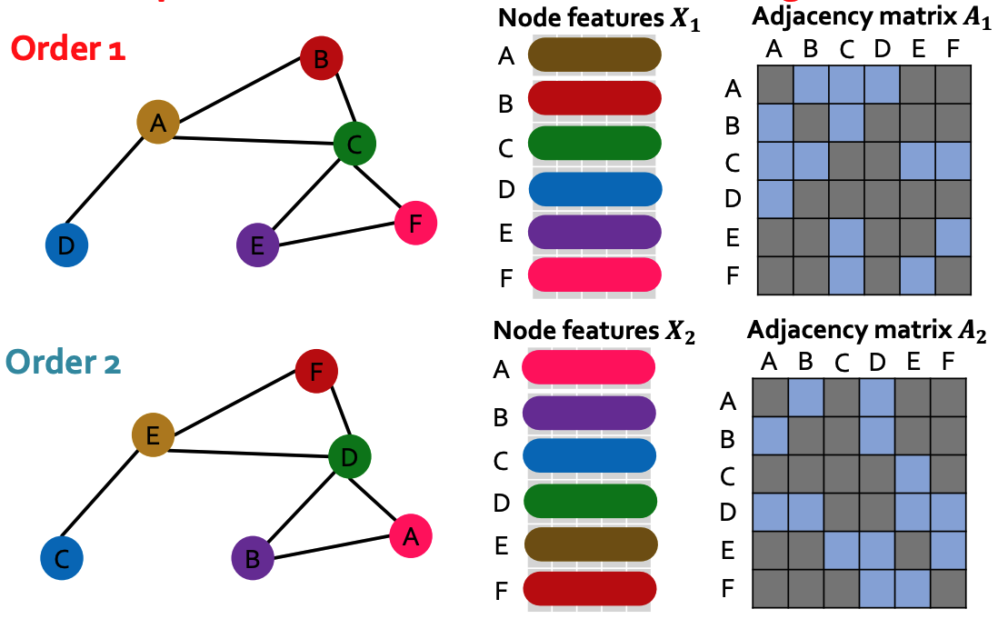

Permutation invariance
Ordering changes node position index in $A$
Learned graph representation should be the same for any ordering
Image credit: Jure Leskovec, http://cs224w.stanford.edu

Slide 23
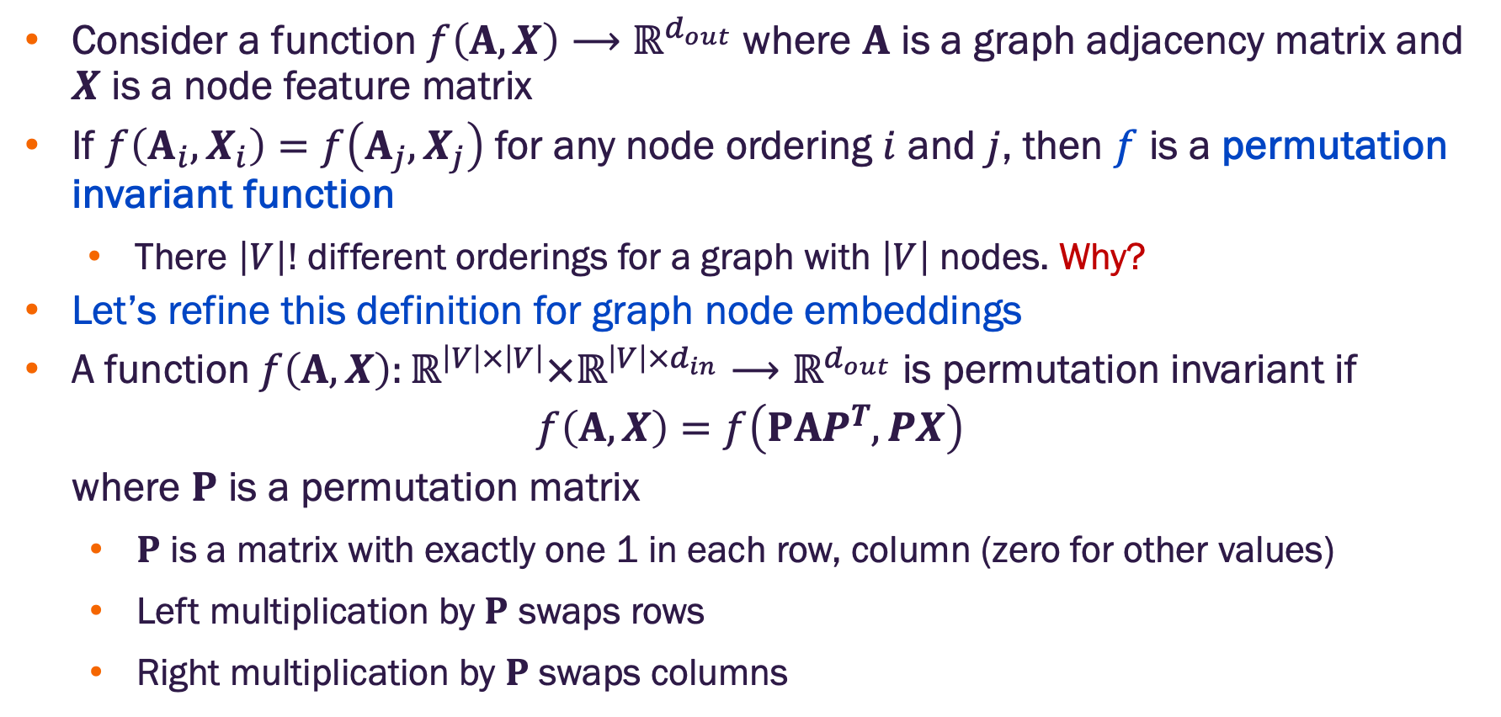
Permutation invariance formal definition
Consider a function $f\left(A,X\right)⟶ℝ^{d_{out}}$ where $A$ is a graph adjacency matrix and $X$ is a node feature matrix
If $f\left(A_{i},X_{i}\right)=f\left(A_{j},X_{j}\right)$ for any node ordering $i$ and $j$, then $f$ is a permutation invariant function
There $\left|V\right|!$ different orderings for a graph with $\left|V\right|$ nodes. Why?
Let’s refine this definition for graph node embeddings
A function$f\left(A,X\right):ℝ^{\left|V\right|×\left|V\right|}×ℝ^{\left|V\right|×d_{in}}⟶ℝ^{d_{out}}$ is permutation invariant if
$$f\left(A,X\right)=f\left(PAP^{T},PX\right)$$
where $P$ is a permutation matrix
$P$ is a matrix with exactly one 1 in each row, column (zero for other values)
Left multiplication by $P$ swaps rows
Right multiplication by $P$ swaps columns
https://ml4g.masinolab.com/topics/gnns/gnn-permutation-demo.html

Slide 24
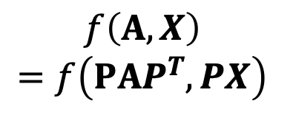
Permutation invariance – node level
For any target node
Same node embedding
$$f\left(A,X\right)$$
$$=f\left(PAP^{T},PX\right)$$
Image credit: Jure Leskovec, http://cs224w.stanford.edu

Slide 25
What about graph “permutation invariance”?
Let’s talk about equivariance.

Slide 26
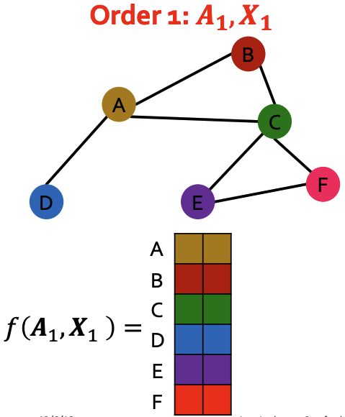
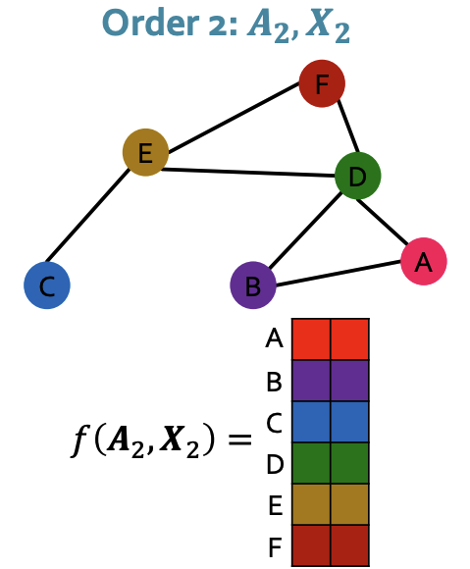
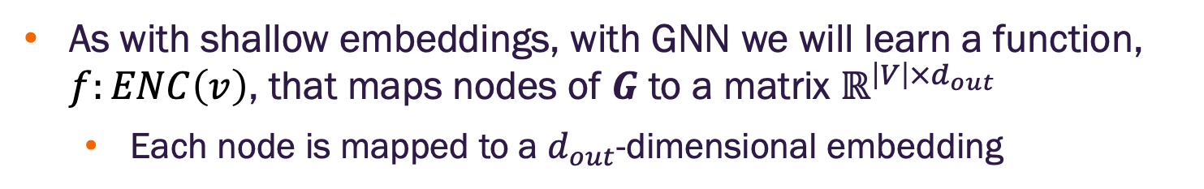
Permutation equivariance
As with shallow embeddings, with GNN we will learn a function, $f:ENC\left(v\right)$, that maps nodes of $G$ to a matrix $ℝ^{\left|V\right|×d_{out}}$
Each node is mapped to a $d_{out}$-dimensional embedding
Image credit: Jure Leskovec, http://cs224w.stanford.edu

Slide 27
Permutation equivariance
As with shallow embeddings, with GNN we will learn a function, $f:ENC\left(v\right)$, that maps nodes of $G$ to a matrix $ℝ^{\left|V\right|×d_{out}}$
Each node is mapped to a $d_{out}$-dimensional embedding
Node A (Order 1) is in the same position as node E (Order 2). It should have the same embedding (invariance)
Image credit: Jure Leskovec, http://cs224w.stanford.edu

Slide 28
Permutation equivariance
As with shallow embeddings, with GNN we will learn a function, $f:ENC\left(v\right)$, that maps nodes of $G$ to a matrix $ℝ^{\left|V\right|×d_{out}}$
Each node is mapped to a $d_{out}$-dimensional embedding
Node C (Order 1) is in the same position as node D (Order 2). It should have the same embedding (invariance)
Image credit: Jure Leskovec, http://cs224w.stanford.edu

Slide 29
Permutation equivariance
As with shallow embeddings, with GNN we will learn a function, $f:ENC\left(v\right)$, that maps nodes of $G$ to a matrix $ℝ^{\left|V\right|×d_{out}}$
Each node is mapped to a $d_{out}$-dimensional embedding
The matrix of all node embeddings should be the same except for row shuffling (permutation)
Image credit: Jure Leskovec, http://cs224w.stanford.edu

Slide 30
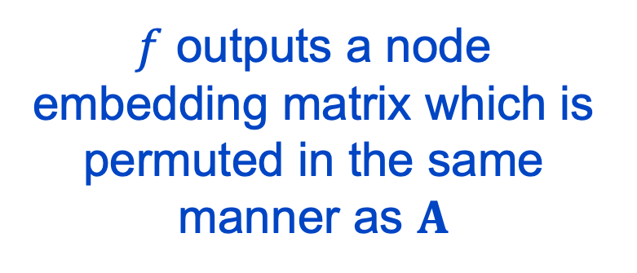
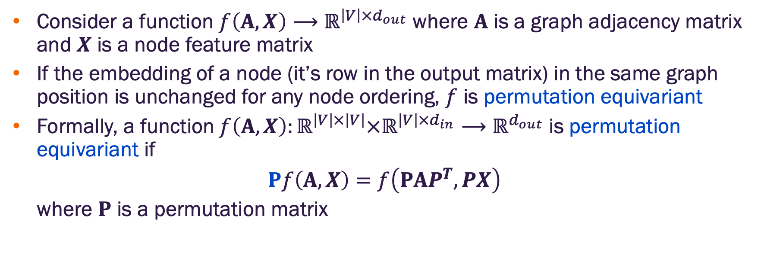
Permutation equivariance formal definition
Consider a function $f\left(A,X\right)⟶ℝ^{\left|V\right|×d_{out}}$ where $A$ is a graph adjacency matrix and $X$ is a node feature matrix
If the embedding of a node (it’s row in the output matrix) in the same graph position is unchanged for any node ordering, $f$ is permutation equivariant
Formally, a function$f\left(A,X\right):ℝ^{\left|V\right|×\left|V\right|}×ℝ^{\left|V\right|×d_{in}}⟶ℝ^{d_{out}}$ is permutation equivariant if
$$Pf\left(A,X\right)=f\left(PAP^{T},PX\right)$$
where $P$ is a permutation matrix
$f$ outputs a node embedding matrix which is permuted in the same manner as $A$
https://ml4g.masinolab.com/topics/gnns/gnn-permutation-demo.html

Slide 31
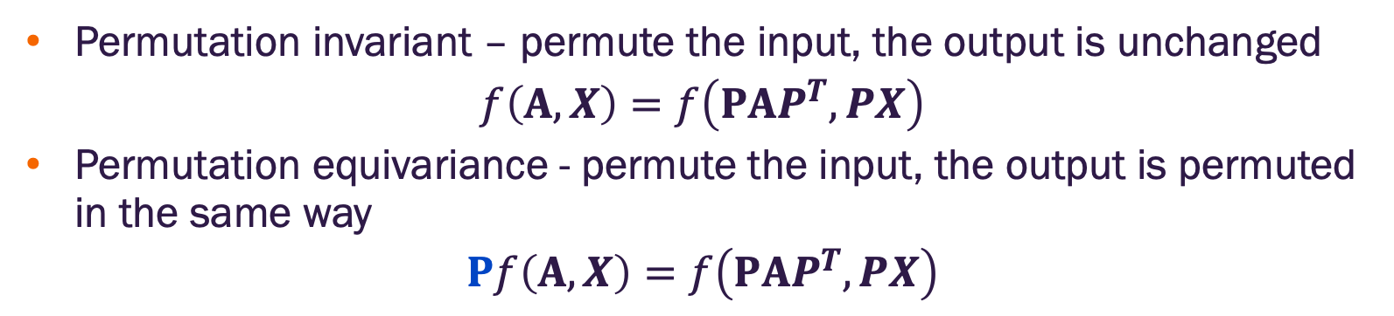
Permutation invariance and equivariance
Permutation invariant – permute the input, the output is unchanged
$$f\left(A,X\right)=f\left(PAP^{T},PX\right)$$
Permutation equivariance - permute the input, the output is permuted in the same way
$$Pf\left(A,X\right)=f\left(PAP^{T},PX\right)$$

Slide 32
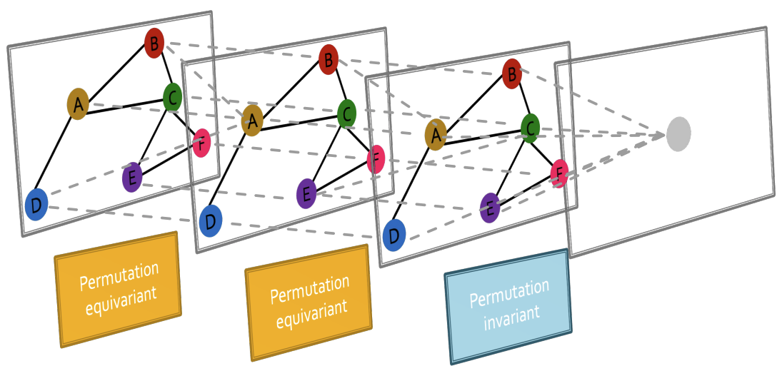
GNNs chain permutation invariant and equivariant operations
Image credit: Jure Leskovec, http://cs224w.stanford.edu

Slide 33
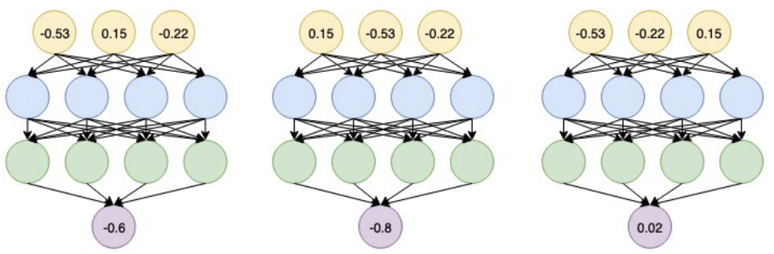
Standard neural networks are permutation sensitive
Are common neural network architectures (linear layers, MLPs, CNNs, RNNs) permutation invariant / equivariant? NO!!!
Changing the input order changes the output. Why?
Image credit: Jure Leskovec, http://cs224w.stanford.edu

Slide 34
Standard neural networks are permutation sensitive
Are common neural network architectures (linear layers, MLPs, CNNs, RNNs) permutation invariant / equivariant? NO!!!
Image credit: Jure Leskovec, http://cs224w.stanford.edu
This is why the naïve approach fails for graphs.

Slide 35
Graph convolution networks

Slide 36
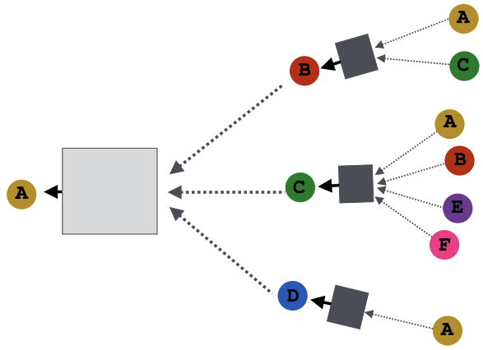
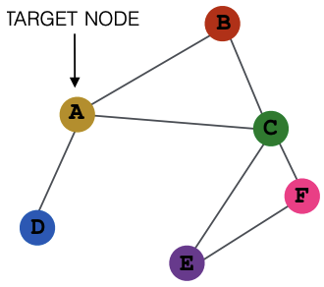
Neighbor node aggregation
Generate node embeddings based on local network neighborhood
Input graph
Image credit: Jure Leskovec, http://cs224w.stanford.edu

Slide 37
Neighbor node aggregation
Generate node embeddings based on local network neighborhood
Input graph
Image credit: Jure Leskovec, http://cs224w.stanford.edu
Neural networks
Notes:
In principle, we want to define a neural network around every node neighborhood. Why? With the correct approach, we’ll obtain the permutation invariance and equivariance properties we desire.
BUT, we need to be efficient and also allow for inductive learning.

Slide 38
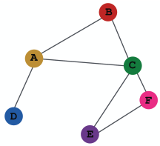
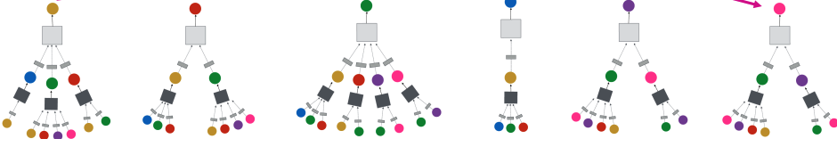
Neighbor node aggregation
Every neighborhood defines a computation graph
Input graph
Each node has a unique computation graph based on its neighborhood
Image credit: Jure Leskovec, http://cs224w.stanford.edu

Slide 39
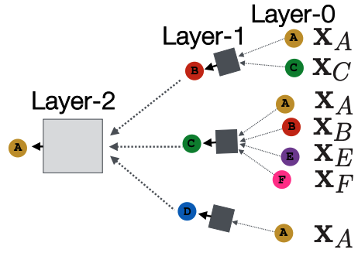
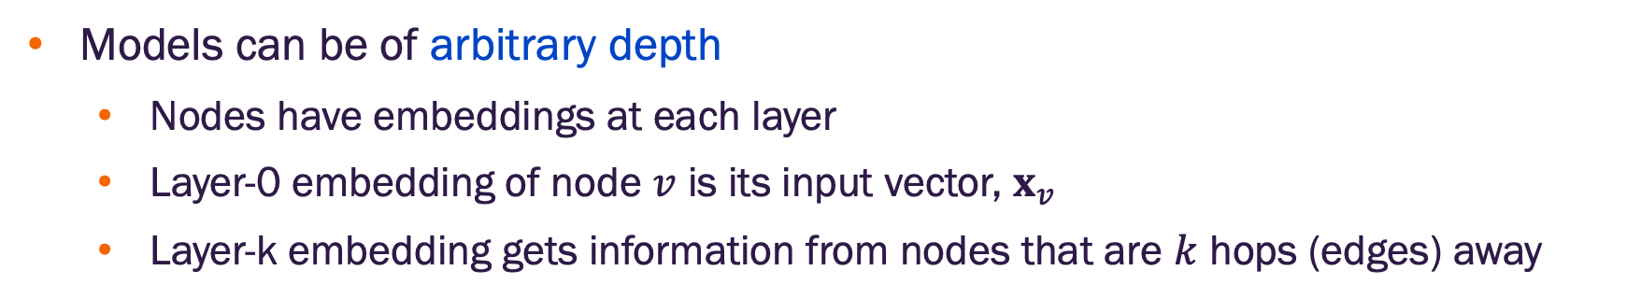
Neighbor node aggregation and layers
Models can be of arbitrary depth
Nodes have embeddings at each layer
Layer-0 embedding of node $v$ is its input vector, $x_{v}$
Layer-k embedding gets information from nodes that are $k$ hops (edges) away
Input graph
Image credit: Jure Leskovec, http://cs224w.stanford.edu
Notes:
Note: At layer-1, the embedding of A is updated by aggregating the input feature vectors of B, C, D. This updated version of A is passed into B , C, and D at layer 2 (not shown). We will introduce self-loops in which case the updated version of A at layer 1, will also be used to update A at layer 2.

Slide 40
Neighbor node computation
One approach: Average the messages (feature vectors) from node neighbors and then apply a neural network
(1) message averaging
Input graph
(2) neural network
Image credit: Jure Leskovec, http://cs224w.stanford.edu
Notes:
Note: At layer-1, the embedding of A is updated by aggregating the input feature vectors of B, C, D. This updated version of A is passed into B , C, and D at layer 2 (not shown). We will introduce self-loops in which case the updated version of A at layer 1, will also be used to update A at layer 2.

Slide 41
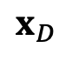
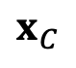
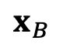
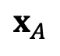
Neighbor node computation
Self loops: To reduce loss of self information, self loops are added so that a node’s own feature vector is used in it’s update
Input graph
(1) self loop
Layer-0
$$x_{A}$$
Layer-1
$$x_{B}$$
$$x_{C}$$
$$x_{D}$$
Image credit: Jure Leskovec, http://cs224w.stanford.edu
Notes:
Note: At layer-1, the embedding of A is updated by aggregating the input feature vectors of B, C, D. This updated version of A is passed into B , C, and D at layer 2 (not shown). We will introduce self-loops in which case the updated version of A at layer 1, will also be used to update A at layer 2.

Slide 42

The math of graph convolution networks
Consider a single node $v$ with neighbors in $N\left(v\right)$
Let $h_{v}^{k}$ be the latent representation of $v$ at layer $k$
$h_{v}^{\left(0\right)}=x_{v}$ is the input feature vector for $v$
At successive layers, where $k∈\left[0,⋯K−1\right]$, $K$ is the number of layers and $σ$ is a non-linear activation
$$h_{v}^{\left(k+1\right)}=σ\left(W^{\left(k\right)}\sum_{u∈N\left(v\right)∪\left\{v\right\}}{\frac{h_{u}^{\left(k\right)}}{\left|N\left(v\right)\right|}}\right)$$
$h_{v}^{\left(K\right)}=z_{v}$
We can input the final embeddings into any loss function and learn the weight parameters using back propagation and SGD
Learnable weight matrix
Final node embedding

Slide 43





Element-wise vector summation
Previous slide, we had $\sum_{u∈N\left(v\right)∪\left\{v\right\}}{\frac{h_{u}^{\left(k\right)}}{\left|N\left(v\right)\right|}}$
$h_{1}^{\left(k\right)}$ embedding
$h_{2}^{\left(k\right)}$ embedding
$h_{3}^{\left(k\right)}$ embedding
$\sum_{j}{h_{j}^{\left(k\right)}}$ embedding

Slide 44

The math of graph convolution networks in matrix form
It will be more efficient if we can put the update equations in matrix form and leverage sparse matrix operations
Let $H^{\left(k\right)}=\left[\begin{aligned}h_{1}^{k} \\ \begin{aligned}⋮ \\ h_{\left[V\right]}^{k}\end{aligned}\end{aligned}\right]$ be the matrix of latent node representations $∀v∈G$
Then letting $A_{v,:}$ be the $v^{th}$ row of the adjacency matrix (with $a_{v,v}=1)$:
$$\sum_{u∈N\left(v\right)∪\left\{v\right\}}{h_{u}^{\left(k\right)}}=A_{v,:}H^{\left(k\right)}$$
Now, let $D$ be a diagonal matrix with diagonal entries $D_{v,v}=deg\left(v\right)=$ $\left|N\left(v\right)\right|$
Then $D^{−1}$ is also diagonal with entries $D_{v,v}^{−1}=1/{\left|N\left(v\right)\right|}$
Finally, we can write the update function across all nodes as
$$\sum_{u∈N\left(v\right)∪\left\{v\right\}}{\frac{h_{u}^{\left(k\right)}}{\left|N\left(v\right)\right|}}⟹H^{\left(k+1\right)}=D^{−1}AH^{\left(k\right)}$$

Slide 45

The math of graph convolution networks in matrix form
From the previous result, we can rewrite the update function over all nodes as:
$$H^{\left(k+1\right)}=σ\left(\tilde{A}H^{\left(k\right)}W^{{\left(k\right)}^{T}}\right)$$
where $\tilde{A}=D^{−1}A$
$\tilde{A}$ is sparse which allows computationally efficient sparse matrix multiplication
Not all GNNs can be expressed in matrix form (depends on the neighborhood aggregation function)
neighborhood
aggregation
normalization

Slide 46

Node embeddings are permutation invariant
The GCN that computes a given node’s embedding is independent of the ordering of the node neighbors due to NNet weight sharing and neighbor averaging
Image credit: Jure Leskovec, http://cs224w.stanford.edu

Slide 47

Embedding matrix of all nodes is permutation equivariant

Slide 48
Embedding matrix of all nodes is permutation equivariant
The input node features and output embeddings have the same row indices.
We know the embedding computation of a given node with a GCN is permutation invariant.
So, permuting moves a given node to a new row in the feature matrix and the adjacency matrix, but also moves the output embedding to the same new row in the embedding matrix. This is permutation equivariance.

Slide 49

Training a GNN
Supervised setting: Minimize a loss function, $ℒ$, with respect to model parameters
$$\min_{Θ}{ℒ\left(y,f_{Θ}\left(x\right)\right)}$$
$y$ is a node, edge, or graph target value
$f_{Θ}\left(x\right)=DEC\left[ENC\left(\left(x\right)\right)\right]$ is a composite function that includes the $DEC$ (typically another NNet) which outputs the estimate, $\hat{y}$, of $y$ given the $ENC$ output which is a node, edge, or graph embedding from a GNN
$ℒ$ is any appropriate loss function, e.g., L2 if $y$ is a real number, or cross entropy if $y$ is categorical
Unsupervised setting
No labels available
Use the graph structure as self-supervision (e.g., link prediction)

Slide 50

Unsupervised GNN training
One approach is to assume similar nodes should have similar embeddings using cross entropy loss:
$$\min_{Θ}{ℒ}=−\sum_{u,v}{\sum_{i=1}^{C}{\left(y_{i}log\left(z_{u}∙z_{v}\right)\right)}}$$
where $y_{i}$ is the actual class label based on a similarity function, $S_{i}$. That is, $y_{i}=1$ if $S_{i}\left(u,v\right)>γ$ for some threshold $γ$.
Can apply any node similarity function, e.g., random walks
Notes:
Note, use of cross entropy allows for multiple similarity functions

Slide 51

Supervised GNN training
As with standard deep-learning, directly train the model for a supervised task such as node classification
Drug-drug interaction network
Is the drug safe or toxic?
Image credit: Jure Leskovec, http://cs224w.stanford.edu

Slide 52

Supervised GNN training
Directly train the model for a supervised task such as node (or graph or edge) classification
Apply cross-entropy loss
$$ℒ=−\sum_{v∈V}{y_{v}log\left[σ\left(DEC\left(z_{v}\right)\right)\right]+\left(1−y_{v}\right)}log\left[1−σ\left(DEC\left(z_{v}\right)\right)\right]$$
Loss gradient is computed for composite function $DEC(ENC\left(v\right))$ and learning parameters are updated for both
$DEC$ can be just the identify function, i.e. just use $σ\left(z_{v}\right)$
encoder output (embedding)
class label
Safe or toxic?
Image credit: Jure Leskovec, http://cs224w.stanford.edu

Slide 53
GNN model design overview
(1) Define the neighborhood aggregation function
(2) Define a loss function
Image credit: Jure Leskovec, http://cs224w.stanford.edu

Slide 54

GNN model design overview
(3) Select training nodes and train the model with SGD
Image credit: Jure Leskovec, http://cs224w.stanford.edu

Slide 55

GCN embedding generation
Once the model is trained, we can generate embeddings for any nodes
Nodes seen in training
Nodes not seen in training
How is this possible?

Slide 56


GCN inductive capacity for unseen or new nodes
The same aggregation learning parameters are shared for all nodes (or edges)
Different parameters at each layer, i.e., $W_{k}≠W_{j}$ for $k≠j$
What does this imply in the math?
Image credit: Jure Leskovec, http://cs224w.stanford.edu

Slide 57

GCN inductive capacity for unseen or new nodes
Recall the math $H^{\left(k+1\right)}=σ\left(\tilde{A}H^{\left(k\right)}W^{{\left(k\right)}^{T}}\right)$
$\tilde{A}∈ℝ^{\left|V\right|×\left|V\right|}$
$H^{\left(k\right)}∈ℝ^{\left|V\right|×d_{k}}$
$W^{{\left(k\right)}^{T}}∈ℝ^{d_{k}×d_{k+1}}$
where $d_{k}$ and $d_{k+1}$ are the latent embedding dimensions at layer $k$ and $k+1$, respectively
The operation $\tilde{A}H^{\left(k\right)}∈ℝ^{\left|V\right|×d_{k}}$ and $\tilde{A}H^{\left(k\right)}W_{k}^{T}∈ℝ^{\left|V\right|×d_{k+1}}$
The weight matrix is not dependent on the adjacency matrix dimensions
We can create a new adjacency matrix to add or remove nodes (and edges) and process it with the same trained model to get embeddings

Slide 58

GCN inductive capacity for unseen or new nodes
Image credit: Jure Leskovec, http://cs224w.stanford.edu
Many applications have dynamic graphs (social networks, device networks)
Can generate new embeddings as needed and pass into downstream inference models
Assumes new nodes have same features and inter-node similarity properties hold

Slide 59

GCN inductive capacity for new graphs
Inductive node embeddings can generalize to an entirely unseen graph (it’s just a new adjacency matrix)
Example: train on known drug molecules and generate embeddings new molecules
Image credit: Jure Leskovec, http://cs224w.stanford.edu

Slide 60

More on GNNs
Interactive visualizations
https://visual-intelligence-umn.github.io/GNN-101/

Slide 61


